Slide 1

The Tokenizer in TensorFlow
Notes:
1

Slide 2
Objectives
Overview the Tokenizer in TensorFlow
Understand the tokenizer in TensorFlow: WhitespaceTokenizer, UnicodeScriptTokenizer, WordpieceTokenizer, BertTokenizer, SentencepieceTokenizer, UnicodeCharTokenizer, HubModuleTokenizer, SplitMergeTokenizer, RegexSplitter
Implement tokenizer in TensorFlow
The Tokenizer in TensorFlow
2

Slide 3
Overview
Tokenization is the process of breaking up a string into tokens.
Commonly, these tokens are words, numbers, and/or punctuation.
The tensorflow_text package provides a number of tokenizers available for preprocessing text required by your text-based models.
The Tokenizer in TensorFlow
3
Notes:
3

Slide 4
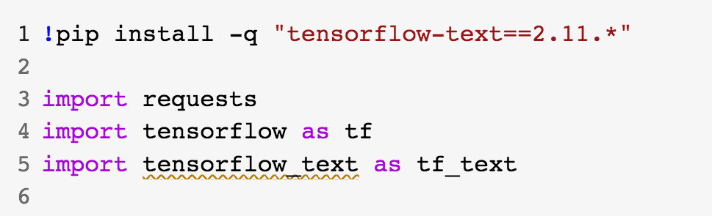
Overview
Setup: you need install the libraries
The Tokenizer in TensorFlow
4
Notes:
4

Slide 5
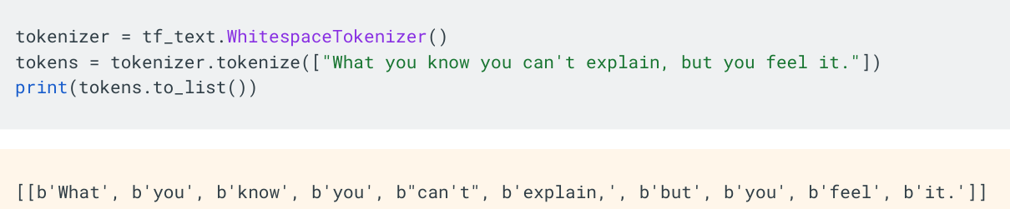
WhitespaceTokenizer
The text.WhitespaceTokenizer is the most basic tokenizer which splits strings on International Components for Unicode( ICU )defined whitespace characters (eg. space, tab, new line). This is often good for quickly building out prototype models.
The Tokenizer in TensorFlow
5
Notes:
5

Slide 6
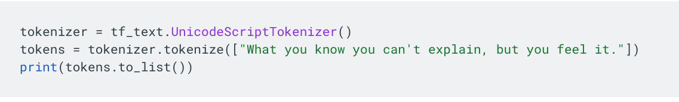
UnicodeScriptTokenizer
The UnicodeScriptTokenizer splits strings based on Unicode script boundaries. The script codes used correspond to International Components for Unicode (ICU) UScriptCode values.
The Tokenizer in TensorFlow
6
Notes:
6

Slide 7
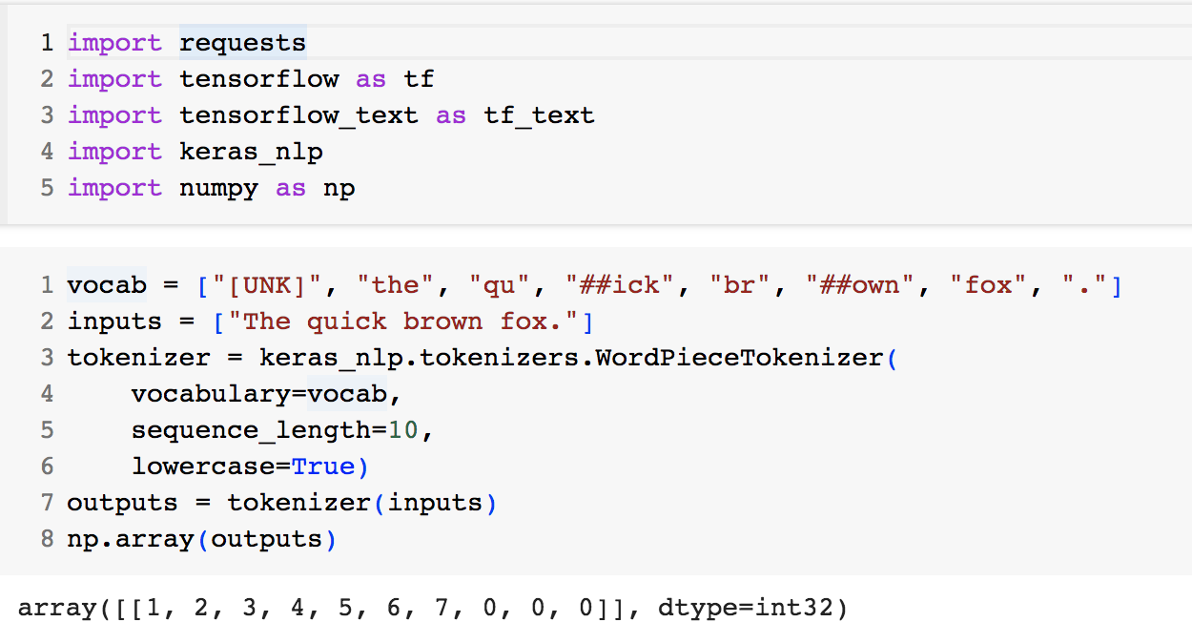
WordpieceTokenizer
WordPiece tokenization is a data-driven tokenization scheme which generates a set of sub-tokens. These sub tokens may correspond to linguistic morphemes, but this is often not the case.
The Tokenizer in TensorFlow
7
Notes:
7

Slide 8
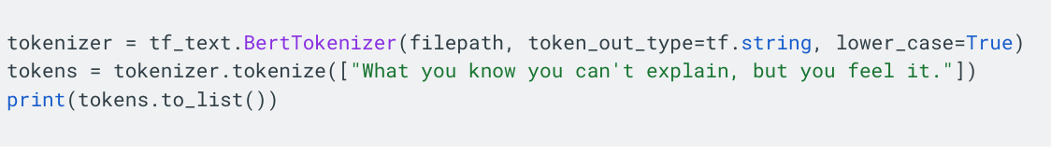
BertTokenizer
The BertTokenizer mirrors the original implementation of tokenization from the BERT paper.
The Tokenizer in TensorFlow
8
Notes:
8

Slide 9
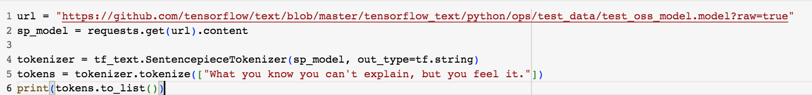
SentencepieceTokenizer
The SentencepieceTokenizer is a sub-token tokenizer that is highly configurable
The Tokenizer in TensorFlow
9
Notes:
9

Slide 10
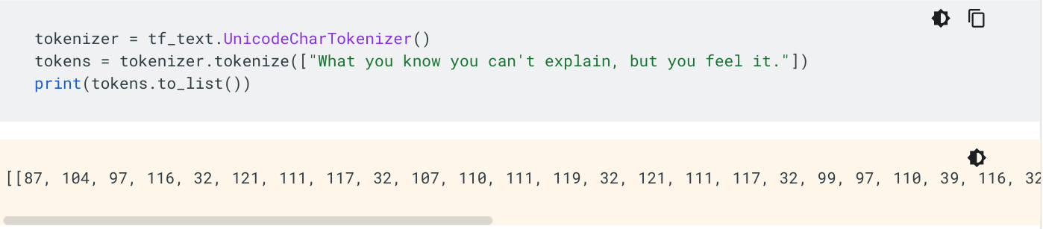
UnicodeCharTokenizer
This splits a string into UTF-8 characters. It is useful for CJK languages that do not have spaces between words.
The Tokenizer in TensorFlow
10
Notes:
10

Slide 11
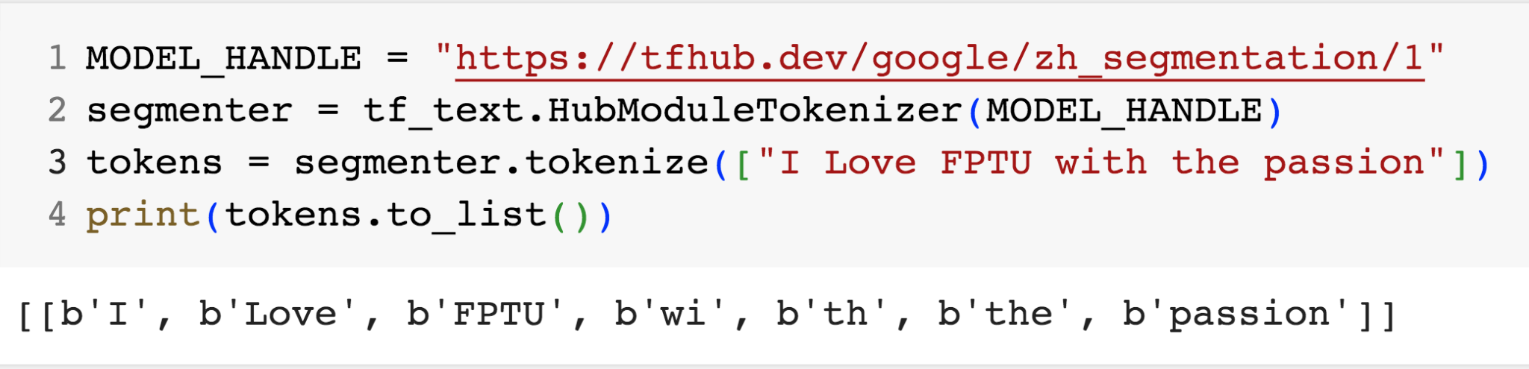
HubModuleTokenizer
This is a wrapper around models deployed to TF Hub to make the calls easier since TF Hub currently does not support ragged tensors.
The Tokenizer in TensorFlow
11
Notes:
11

Slide 12
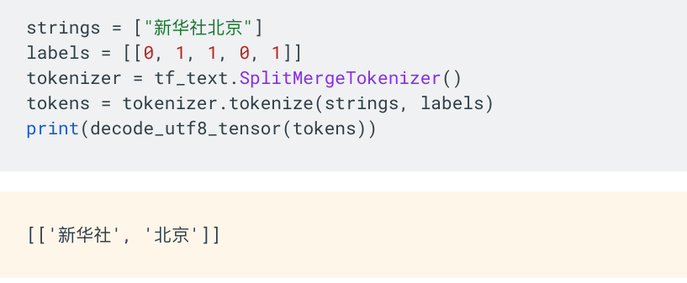
SplitMergeTokenizer
The SplitMergeTokenizer has a targeted purpose of splitting a string based on provided values that indicate where the string should be split.
For the SplitMergeTokenizer, a value of 0 is used to indicate the start of a new string, and the value of 1 indicates the character is part of the current string.
The Tokenizer in TensorFlow
12
Notes:
12

Slide 13
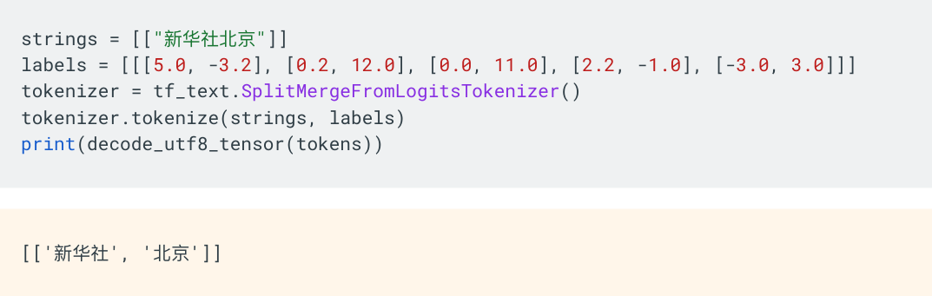
SplitMergeFromLogitsTokenizer
SplitMergeFromLogitsTokenizer have a targeted purpose of splitting a string based on provided values that indicate where the string should be split
It instead accepts logit value pairs from a neural network that predict if each character should be split into a new string or merged into the current one.
The Tokenizer in TensorFlow
13
Notes:
13

Slide 14
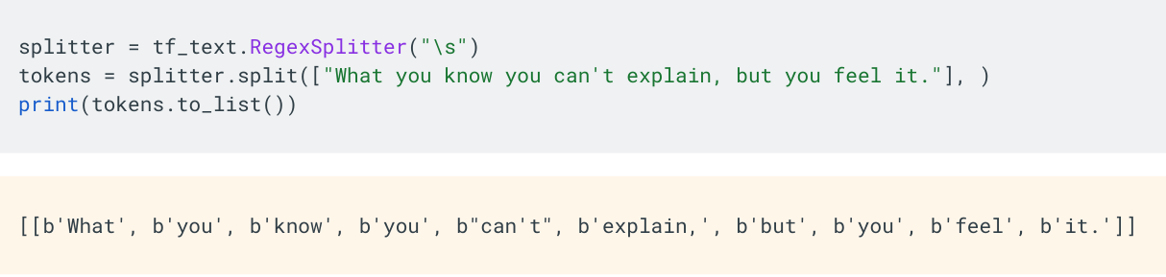
RegexSplitter
The RegexSplitter is able to segment strings at arbitrary breakpoints defined by a provided regular expression.
The Tokenizer in TensorFlow
14
Notes:
14

Slide 15
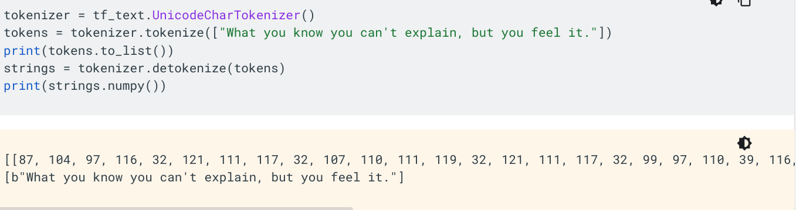
Detokenization
Tokenizers which implement the Detokenizer provide a detokenize method which attempts to combine the strings. This has the chance of being lossy, so the detokenized string may not always match exactly the original, pre-tokenized string.
The Tokenizer in TensorFlow
15
Notes:
15

Slide 16
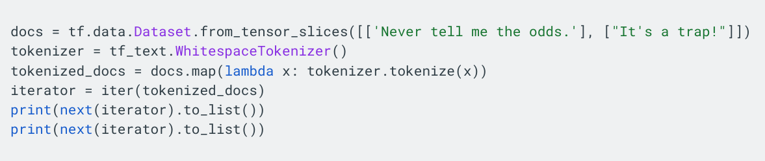
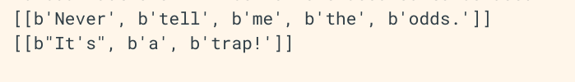
TF Data
TF Data is a powerful API for creating an input pipeline for training models. Tokenizers work as expected with the API.
The Tokenizer in TensorFlow
16
Notes:
16

Slide 17
Summary
Overview the Tokenizer in TensorFlow
Understand the tokenizer in TensorFlow: WhitespaceTokenizer, UnicodeScriptTokenizer, WordpieceTokenizer, BertTokenizer, SentencepieceTokenizer, UnicodeCharTokenizer, HubModuleTokenizer, SplitMergeTokenizer, RegexSplitter
Implement tokenizer in TensorFlow
The Tokenizer in TensorFlow
17

Slide 18
Q & A
The Tokenizer in TensorFlow
18

